Slide 1
NBKR INSTITUTE OF SCIENCE AND TECHNOLOGY FILE MANAGEMENT TOOLS
SUBMITTED BY : G.JYOTHSNA REDDY(24KB1A05K5)
S.JASMITHA(24KB1A05JV)
GURU NIKITHA(24KB1A05LV)

Slide 2
INTRODUCTION
This project simulates a basic File Allocation Table (FAT)-like file management system.
It allows users to create, delete, rename, and search for files using an array or linked list structure.
The system mimics how file systems manage file metadata and storage blocks.
It provides a simplified model to understand file operations and memory allocation.
It demonstrates internal file handling mechanisms without relying on a real file system.
.

Slide 3
OBJECTIVE
To develop a simplified file system that simulates basic file operations like create, delete, rename, and search.
To implement file management using data structures such as arrays or linked lists.
To mimic the behavior of a File Allocation Table (FAT) for educational and experimental purposes.
To enhance understanding of memory allocation and directory management techniques in operating systems.

Slide 4
HOW TO CREATE A FILE ?
To create a file, prompt the user to enter a file name.
Check if the file already exists in the file list (array or linked list).
If not, allocate a new entry in the structure and store the file name with A unique identifier or index.
Update the file list to reflect the new file, simulating how FAT tracks file metadata.

Slide 5
HOW TO DELETE A FILE?
To delete a file, prompt the user to enter the file name.
Search the file list (array or linked list) for a matching file entry.
If found, remove the file entry from the list and free the associated space.
Update the structure to reflect the deletion, simulating how FAT marks file blocks as available.

Slide 6
How to rename a file?
To rename a file, prompt the user to enter the current file name and the new name.
Search the file list (array or linked list) for the existing file.
If found, check that the new name does not already exist to avoid duplicates.
Update the file name in the structure to the new name, simulating a rename operation in a FAT
System.

Slide 7
HOW TO SEARCH A FILE?
Traverse the array or linked list that stores file metadata (name, location, etc.).
Compare each file's name with the target name using string comparison.
If a match is found, return the file's details or its index/node.
If the end is reached without a match, report the file as not found.

Slide 8
algorithm
Start the program
Initialize the linked list head as NULL and the next Start Block counter as 0.
Display Menu Continuously (Loop)
Display a menu with options:
Create File
Delete File
Rename File
Search File
Display Files
Exit

Slide 9
algorithm
Algorithm for Simple File Management System**
+1. **Initialization**
- Initialize a pointer `head` to `NULL` to represent the start of the file list.
- Initialize an integer `nextStartBlock` to `0` to simulate a block allocation counter.
---
2. **Main Loop**
- Display the menu:
1. Create File
2. Delete File
3. Rename File
4. Search File
5. Display Files
6. Exit
- Accept user input for choice.
- Use a switch-case to execute the corresponding operation.
---
3. **Create File Operation**
- Input: File name and size.
- Traverse the linked list:
- If a file with the same name exists, print an error and return.
- Allocate memory for a new file.
- Set file properties: name, size, and `startBlock = nextStartBlock`.
- Insert the new file at the beginning of the linked list.
- Update `nextStartBlock += size`.
- Print success message.

Slide 10
### 4. **Delete File Operation**
- Input: File name.
- Traverse the list to find the file.
- If found:
- Remove it from the list.
- Free the allocated memory.
- Print success message.
- If not found:
- Print "File not found" message.
---
### 5. **Rename File Operation**
- Input: Current name and new name.
- Traverse the list:
- If a file with the new name already exists, abort with error.
- If file with the current name is found, update its name.
- Print success or error message.

Slide 11
### 6. **Search File Operation**
- Input: File name.
- Traverse the list:
- If found, display file details.
- If not found, print message.
---
### 7. **Display All Files**
- If the list is empty, print "No files."
- Otherwise, traverse the list and print each file’s name, size, and start block.
---
### 8. **Exit Program**
- Free all allocated memory using a cleanup function.
- Exit the loop.

Slide 12
Source code
https://onlinegdb.com/9RknpJAnCw

Slide 13
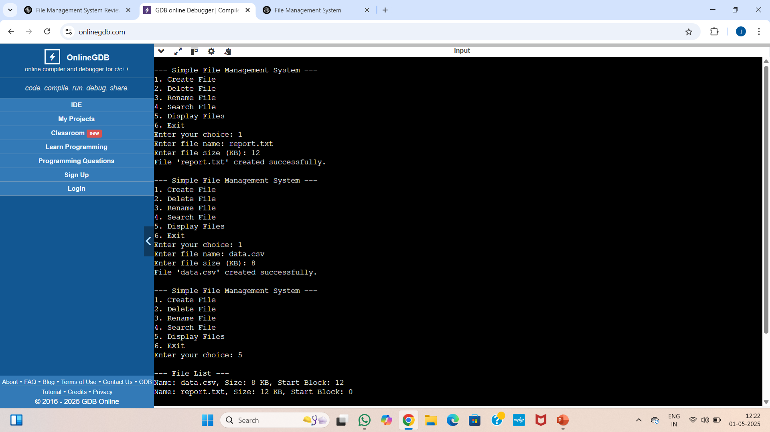
Output:

Slide 14
CONCLUSION
In a File Management Tool that simulates a FAT-like file system, implementing operations such as create, delete, rename, and search using arrays or linked lists provides valuable insight into basic file system architecture. Arrays offer simplicity and faster access times but are limited in scalability, while linked lists allow dynamic memory management at the cost of slower traversal. Each data structure presents trade-offs that influence performance and flexibility, making the choice dependent on specific application requirements. Overall, this simulation helps users understand how fundamental file operations are managed at a low level within an operating system.

Slide 15
Thank you

